Slide 1
Function Point Estimation
Sachin Lakra
Associate Professor
Department of Computer Science and Technology
Manav Rachna University
Faridabad

Slide 2
FUNCTION POINT ANALYSIS
Alan Albrecht while working for IBM, recognized the problem of the measurement of the size of a software project in the 1970s, and developed a technique (which he called Function Point Analysis), which appeared to be a solution to the size measurement problem.

Slide 3
Function Points Analysis
The function point is a size-oriented metric for measuring the functionality of an application. The technique measures functionality by measuring the following parameters related to the application:
  External enquiries
  Inputs
  Outputs
  Master files
  Interfaces to other applications
The method assigns numeric values to user deliverables.
It is independent of any programming language or any technology since it measures external functions

Slide 4
Components of function point calculations
The components of function point calculations are:
Project Elements × Weight factors = Total Function Points (TFP)
Σ (No. of questions × Degree of Complexity)
= Total Adjusted Function Points (TAFP)
(Find degree of complexity for each of 14 questions. Some questions might have the same degree. Count these questions together and multiply by the same degree of complexity.)
Function Points = Total Function Points (TFP) ×
(0.65 + (Σ TAFP × 0.01))

Slide 5
Project elements
Project elements consist of the following 5 elements:
  External Input Types or Inputs
    Provide user communication to an application
    E.g., input documents, screens, forms, keyed inputs, etc
  External Output Types or Outputs
    Provide user communication from an application
    E.g., printed reports, error messages
  External Inquiry Types or Inquiries
    A search for specific information,
    E.g., A query for data using a primary key

Slide 6
Project elements (contd.)
  Logical Internal File Types or Master Files
    Comprise each logical file grouping of data from the viewpoint of the user
    E.g., a table in the database or a view
  External Interface File Types or Interfaces
    Include major automated interfaces to other applications that are not transactions
    E.g., bulk transfer of accounts data to another application

Slide 7
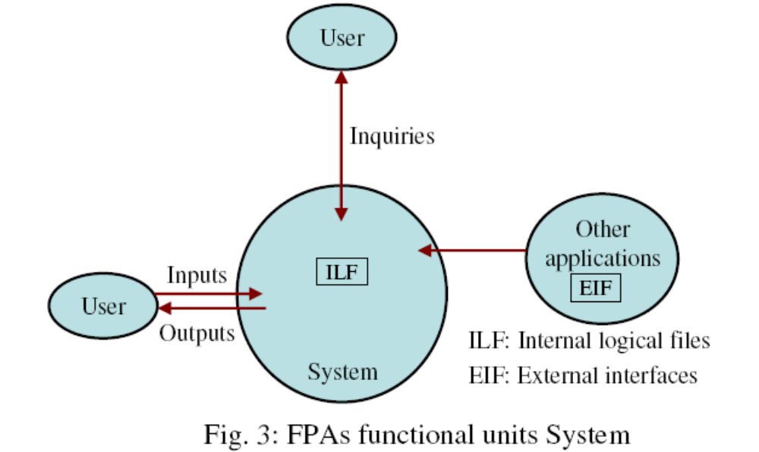

FPA Functional Units of a system

Slide 8
Calculation of Total Function Points
Project Element | Element Count N | Weight W |  |  | Function Points F=N × W
 |  | Simple | Average | Complex
Inputs | 5 | 3 | 4 | 6 | 20
Outputs | 7 | 4 | 5 | 7 | 35
Inquiries |  | 3 | 4 | 6
Master Files |  | 7 | 10 | 15
Interfaces |  | 5 | 7 | 10
Total Function Points (TFP) |  |  |  |  | (Σ F) 600

Slide 9
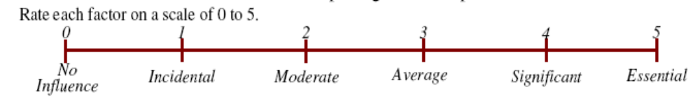
Calculation of Degree of Complexity
The Degree of Complexity is calculated based on the score of each of the 14 questions given below on the following scale:
  0 No influence
  1 Incidental
  2 Moderate
  3 Average
  4 Significant
  5 Essential

Slide 10
The 14 questions
Does the system require reliable backup and recovery?
Are data communications required?
Are there distributed processing transactions?
Is performance critical?
Will the system run in an existing, heavily utilized operational environment?
Does the system require online data entry?
Does online data entry require the input transaction to be built over multiple screens or operations?

Slide 11
The 14 questions (contd..)
Are the master files updated online?
Are the inputs, outputs, files or inquiries complex?
Is the internal processing complex?
Is code designed to be reusable?
Are conversion and installation included in the design?
Is the system designed for multiple installations in different organizations?
Is the application designed to facilitate change and ease of use by the user?

Slide 12
Metrics based on Function Points
Functions points may compute the following important metrics:
Productivity = FP / Effort (persons-months)
Quality = Defects / FP
Cost = Rupees / FP
Documentation = Pages of documentation per FP

Slide 13
Features of FPA
Function point approach is independent of the language, tools, or methodologies used for implementation; i.e. they do not take into consideration programming languages, data base management systems, processing hardware or any other data base technology.
Function points can be estimated from requirement specification or design specification, thus making it possible to estimate development efforts in early phases of development.

Slide 14
Features of FPA
Function points are directly linked to the statement of requirements; any change of requirements can easily be followed by a re-estimate.
Function points are based on the user’s external view of the system, non-technical users of the software system have a better understanding of what function points are measuring.

Slide 15
Question 1
Q1. Consider a project with the following functional units:
Number of user files = 06
Number of external interfaces = 04
Number of user outputs = 40
Number of user inputs = 50
Number of user enquiries = 35
Assume all complexity adjustment factors(CAF) and weighting factors are average. Compute the function points for the project.

Slide 16
Solution to Q1
Calculation of Total Function Points
Project Element | Element Count N | Weight W or Weighting factors |  |  | Function Points F=N × W
 |  | Simple | Average | Complex
Inputs | 50 | 3 | 4 | 6 | 200
Outputs | 40 | 4 | 5 | 7 | 200
Inquiries | 35 | 3 | 4 | 6 | 140
Master Files | 06 | 7 | 10 | 15 | 60
Interfaces | 04 | 5 | 7 | 10 | 28
Total Function Points (TFP) |  |  |  |  | Σ F = 628

Slide 17
Solution to Q1
Value of each of 14 questions is average, that is, 3
Σ (No. of questions × Degree of Complexity)
= Total Adjusted Function Points (TAFP)
TAFP = 14 X 3 =42
FP = Total Function Points (TFP) ×
(0.65 + (Σ TAFP × 0.01))
FP = 628 X (0.65 + (42 X 0.01)) = 671.96

Slide 18
Question 2
Q1. Consider a project with the following functional units:
Number of user files = 06 (WF=Average)
Number of external interfaces = 04 (WF = Simple)
Number of user outputs = 40 (WF = Simple)
Number of user inputs = 50 (WF = Complex)
Number of user enquiries = 35 (WF = Complex)
3 questions have a complexity adjustment factor (CAF) of 3, 4 questions have a CAF of 2 and 7 questions have a CAF of 5
Compute the function points for the project.

Slide 19
Solution to Q2
Calculation of Total Function Points
Project Element | Element Count N | Weight W or Weighting factors |  |  | Function Points F=N × W
 |  | Simple | Average | Complex
Inputs | 50 | 3 | 4 | 6 | 50X6=300
Outputs | 40 | 4 | 5 | 7 | 40X4=160
Inquiries | 35 | 3 | 4 | 6 | 35X6=210
Master Files | 06 | 7 | 10 | 15 | 6X10=60
Interfaces | 04 | 5 | 7 | 10 | 4X5=20
Total Function Points (TFP) |  |  |  |  | Σ F = 650

Slide 20
Solution to Q2
Σ (No. of questions × Degree of Complexity)
= Total Adjusted Function Points (TAFP)
TAFP = (3X3 + 4X2 + 7X5)=9+8+35=52
FP = Total Function Points (TFP) ×
(0.65 + (Σ TAFP × 0.01))
FP = 650 X (0.65 + (52 X 0.01))
= 650 X (0.65 + 0.52) = 650 X 1.17 = 760.5

Slide 21
Question 3
Given the following:
FP = 576.23, Effort = 43.8 person-months
Defects = 35 per KLOC, Cost = Rs. 9876/month
Documentation = 296 pages
calculate productivity, documentation, cost per function point and quality.

Slide 22
Solution to Q3
Productivity = FP / persons-months
= 576.23/43.8 = 13.1559
Quality = Defects / FP
= 35/576.23 = 0.0607
Cost = Rupees / FP
= 9876/576.23 = 17.1389
Documentation = Pages of documentation per FP = 296/576.23 = 0.5136

Slide 23
Thank You

